Slide 1

Prime Age In the NBA
By Devin Harty

Slide 2

Why?
Big NBA Fan
Love Sports betting
Curious about when NBA players hit their peak performance
Fascinated with how Athletic performance changes with age

Slide 3
Variables sed
Age | Points
Age Squared | Assists
Minutes Played | Total Rebounds
Field Goals Attempted | Games Played
Field Goals Made | Turnovers
Three Pointers Attempted | Free Throws Attempted

Slide 4
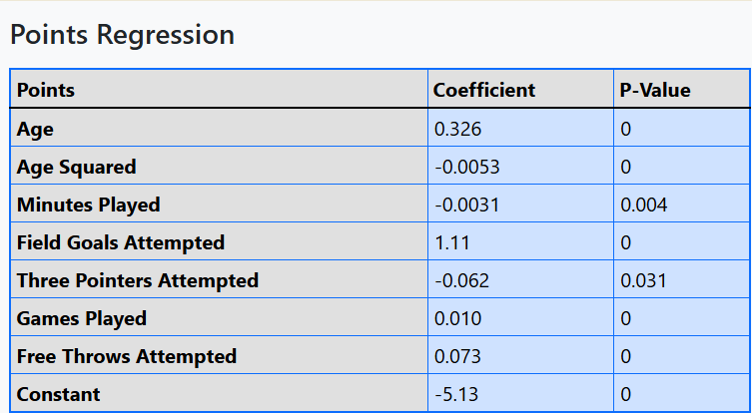
R-squared: 0.9845

Slide 5
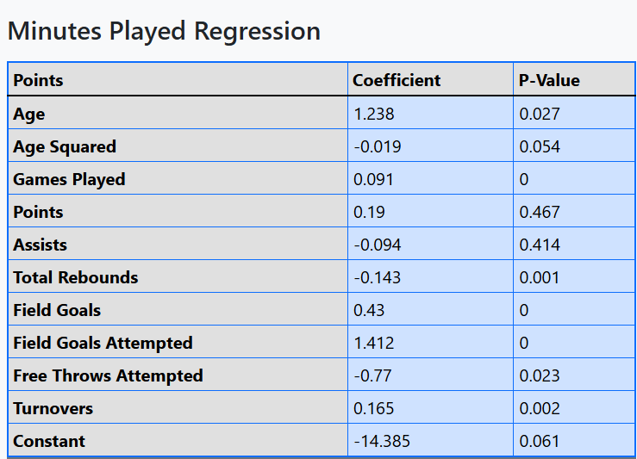
Minutes Played Regression
R-Squared: 0.9696

Slide 6
Conclusions
Tried a bunch of different regressions on a bunch of different stats, these were the most accurate
At age 30.75 players Score the most points
At age 31.75 players play the most amount of minutes
Average age of an NBA all star is 26-27, and outside Research shows that NBA players tend to peak around the age of 28
As Medicine and Technology gets better, so does the age of NBA players

